Slide 1
Reinforcement Learning

Slide 2
Double Bandits
This MDP problem consists of two states, "Win" and "Lose", and two actions, "Play Red" and "Play Blue".
The agent transitions between states based on the action it takes and receives a corresponding reward.

Slide 3
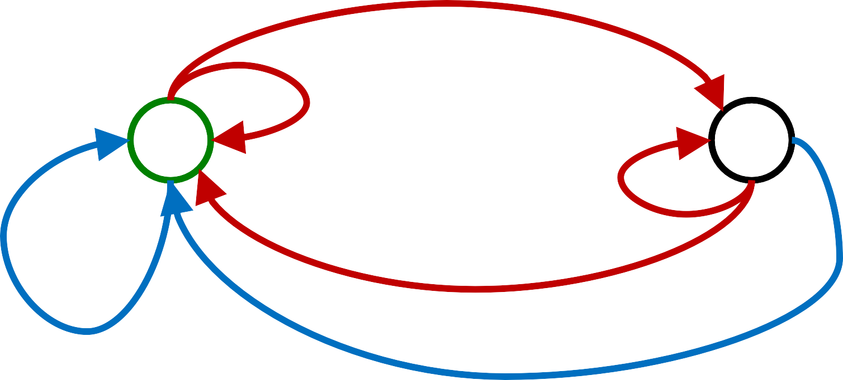
Double-Bandit MDP
Actions: Blue, Red
States: Win, Lose
No discount
10 time steps Both states have the same value
0.25 $0
0.75
$2
W
0.25
$0
L
$1
$1
0.75 $2
1.0
1.0

Slide 4

Offline Planning
Solving MDPs is offline planning
  You determine all quantities through computation
  You need to know the details of the MDP
  You do not actually play the game!
No discount
10 time steps
0.75
$2
W
0.25
$0
0.75 $2
L
$1
$1
1.0
1.0

Slide 5
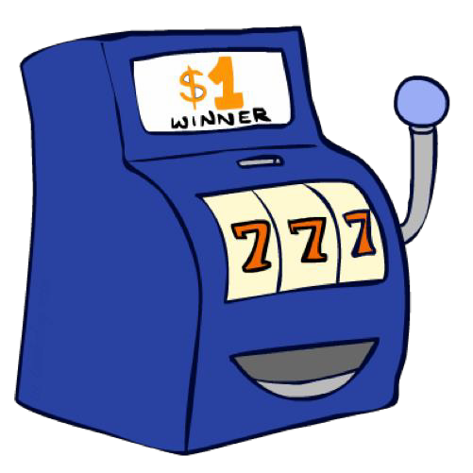
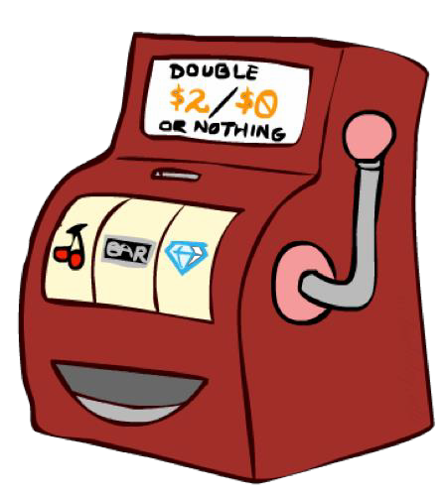
Let’s Play!
$2 | $2 | $0 | $2 | $2
$2 | $2 | $0 | $0 | $0

Slide 6

Online Planning
o Rules changed! Red’s win chance is different.
?? $0
??
$2
W
??
$0
L
$1
$1
?? $2
1.0
1.0

Slide 7
Let’s Play!
$0 $0 | $2 | $0
$0 $2 | $2 | $0 | $0
$0

Slide 8
What Just Happened?
That wasn’t planning, it was learning!
MDP
  You know the rewards and transitions (i.e., the model of the world) beforehand.
  Find a policy to maximize total reward
  Run our MDP solvers offline
  Only deploy the optimal policy
Reinforcement Learning
  You don’t know rewards and transitions beforehand .
  Still assume the world is an MDP
  Do not know how the world works
  Find policy to maximize total reward
  Need to take actions in the world to understand the world

Slide 9
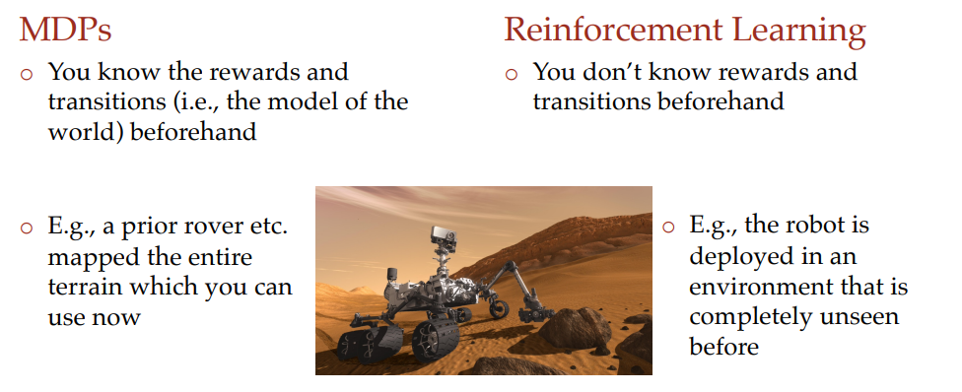

Slide 10
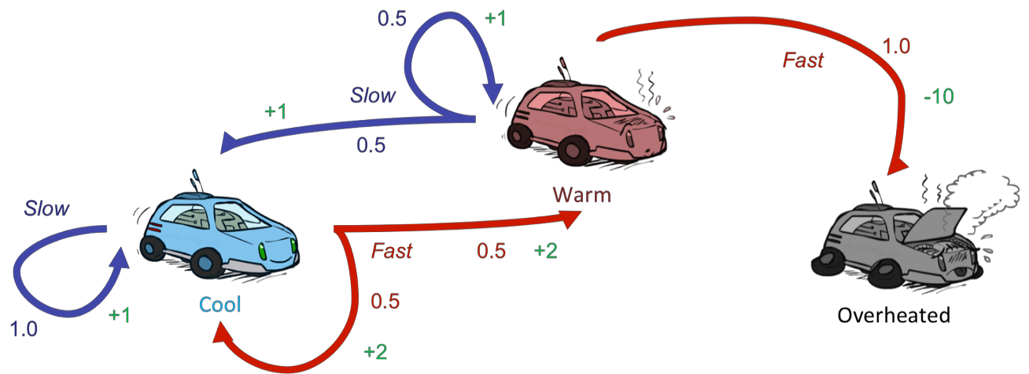
Reinforcement Learning
Still assume a Markov decision process (MDP):
  A set of states s ∈ S
  A set of actions (per state) A
  A model T(s,a,s’)
  A reward function R(s,a,s’)
Still looking for a policy π(s)
New twist: don’t know T or R
  I.e. we don’t know which states are good or what the actions do
  Must actually try actions and states out to learn

Slide 11
Reinforcement Learning (online planning)
Basic idea:
  online planning, during which an agent has no prior knowledge of rewards or transitions in the world (still represented as a MDP)
Agent
State: s
Reward: r
Actions: a
Environment
  Exploration: you have to try unknown actions to get information and receive feedback in the form of successor states and corresponding rewards.
  Agent’s utility is defined by the reward function
  Must (learn to) act so as to maximize expected rewards
  All learning is based on observed samples of outcomes!
  Exploitation: this feedback to estimate an optimal policy through a process known as reinforcement learning before using this estimated policy for exploitation or reward maximization

Slide 12



Example: Learning to Walk
Initial
A Learning Trial
After Learning [1K Trials]
[Kohl and Stone, ICRA 2004]

Slide 13

Robotics Rubik Cube
o https://www.youtube.com/watch?v=x4O8pojMF0w

Slide 14
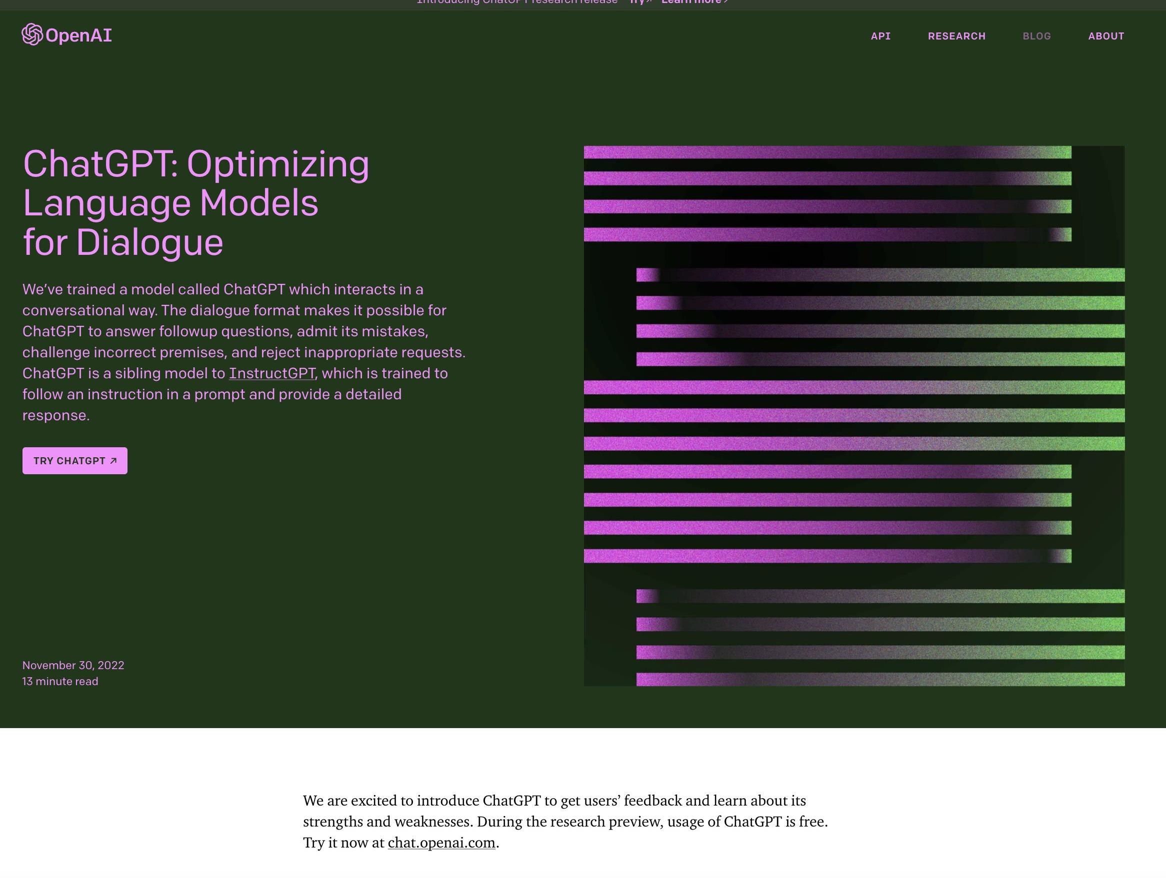
19

Slide 15
Reinforcement Learning
Still assume a Markov decision process (MDP):
  A set of states s ∈ S
  A set of actions (per state) A
  A model T(s,a,s’)
  A reward function R(s,a,s’)
    At each time step during online planning, an agent starts in a state s, then takes an action a and ends up in a successor state s ′ , attaining some reward r.
    Each (s,a,s ′ ,r) tuple is known as a sample.
    An agent continues to take actions and collect samples in succession until arriving at a terminal state. Such a collection of samples is known as an episode.
    Agents typically go through many episodes during exploration in order to collect sufficient data needed for learning.

Slide 16
Reinforcement Learning
Still looking for a policy π(s)
New twist: don’t know T or R
  I.e. we don’t know which states are good or what the actions do
  Must actually try actions and states out to learn

Slide 17
Reinforcement learning approaches
Model based RL
  First estimate T(s, a, s’) and R(s, a, s’) with the samples attained during exploration .
  Use these estimates to solve the MDP normally with value or policy iteration.
Model-free RL
  Could be wasteful to estimate T(s, a, s’) and R(s, a, s’)
  Estimate V^{π}and Q ^{π} directly without ever using any memory to construct a model of the rewards and transitions in the MDP.

Slide 18


Model-Based Learning
Model-Based Idea:
  an agent generates an approximation of the transition function, Tˆ(s,a,s ′ ), by keeping counts of the number of times it arrives in each state s ′ after entering each Q-state (s,a).
  Solve for values as if the learned model were correct
Step 1: Learn empirical MDP model
  Count outcomes s’ for each s, a
  Normalize to give an estimate
of
o Discover each
when we experience (s, a, s’)
o Step 2: Solve the learned MDP
o For example, use value iteration, as before

Slide 19
Example: Model-Based Learning
Input Policy π
Observed Episodes (Training)
Learned Model
Episode 1
B, east, C, -1
C, east, D, -1
D, exit, x, +10
Episode 2
B, east, C, -1
C, east, D, -1
D, exit, x, +10
 | A
B | C | D
 | E
T(B, east, C) = 1.00
T(C, east, D) = 0.75
T(C, east, A) = 0.25
…
Episode 3
E, north, C, -1
Episode 4
E, north, C, -1
R(B, east, C) = -1
R(C, east, D) = -1
R(D, exit, x) = +10
…
C, east, D, exit,
D, -1
x, +10
C, east,
A, exit,
A, -1
x, -10
Assume: γ = 1

Slide 20
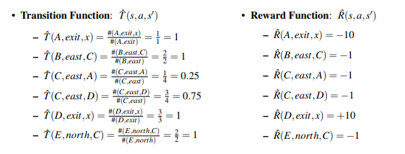
Example: Model-Based Learning

Slide 21
Example: Model-Based Learning
By the law of large numbers, as we collect more and more samples by having our agent experience more episodes, our models of Tˆ and Rˆ will improve.
With Tˆ converging towards T and Rˆ acquiring knowledge of previously undiscovered rewards as we discover new (s,a,s ′ ) tuples.
Whenever we see fit, we can end our agent’s training to generate a policy π_{exploit} by running value or policy iteration with our current models for Tˆ and Rˆ and use π_{exploit} for exploitation.
It can be expensive to maintain counts for every (s,a,s ′ ) tuple seen

Slide 22
Model-Free Learning
Passive RL
  Suppose policy 𝜋 being used is already given to you
  Only worry about how to learn from experience i.e learns the value of states under that policy as it experiences episodes.
  Agent does not control the policy 𝜋 of taking actions
Active RL
  the learning agent can use the feedback it receives to iteratively update its policy while learning until eventually determining the optimal policy after sufficient exploration.

Slide 23
Direct Evaluation
Goal: Compute values for each state under π
Idea: Average together observed sample
values
  Act according to π
  Every time you visit a state, write down what is the
sum of discounted rewards turned out to be.
  Average those samples
This is called direct evaluation

Slide 24
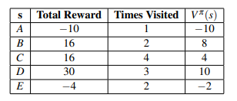
Example: Direct Evaluation
Input Policy π
Observed Episodes (Training)
Output Values
Episode 1
B, east, C, -1
C, east, D, -1
D, exit, x, +10
Episode 2
B, east, C, -1
C, east, D, -1
D, exit, x, +10
 | A
B | C | D
 | E
Episode 3
E, north, C, -1
Episode 4
E, north, C, -1
C, east, D, exit,
D, -1
x, +10
C, east,
A, exit,
A, -1
x, -10
 | -10 A
+8 B | +4 C | +10 D
 | -2 E
Assume: γ = 1
Total reward from state to termination

Slide 25
Problems with Direct Evaluation
What’s good about direct evaluation?
  It’s easy to understand
  It doesn’t require any knowledge of T, R
  It eventually computes the correct average
values, using just sample transitions
Output Values
 | -10 A
+8 B | +4 C | +10 D
 | -2 E
What bad about it?
  It wastes information about state connections
If B and E both go to C under this policy, how can their values be different?

Slide 26
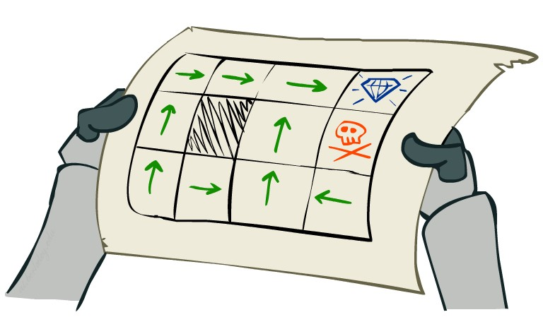
Passive Reinforcement Learning
Simplified task: policy evaluation
  Input: a fixed policy π(s)
  You don’t know the transitions T(s,a,s’)
  You don’t know the rewards R(s,a,s’)
  Goal: learn the state values
In this case:
  Learner is “along for the ride”
  No choice about what actions to take
  Just execute the policy and learn from experience
  This is NOT offline planning! You actually take actions in the world.

Slide 27

Why Not Use Policy Evaluation?
o Simplified Bellman updates calculate V for a fixed policy:
o Each round, replace V with a one-step-look-ahead layer over V
s
π(s) s, π(s)
s, π(s),s’
s’
This approach fully exploited the connections between the states
Unfortunately, we need T and R to do it!
o Key question: how can we do this update to V without knowing T and R?
o In other words, how to we take a weighted average without knowing the weights?

Slide 28
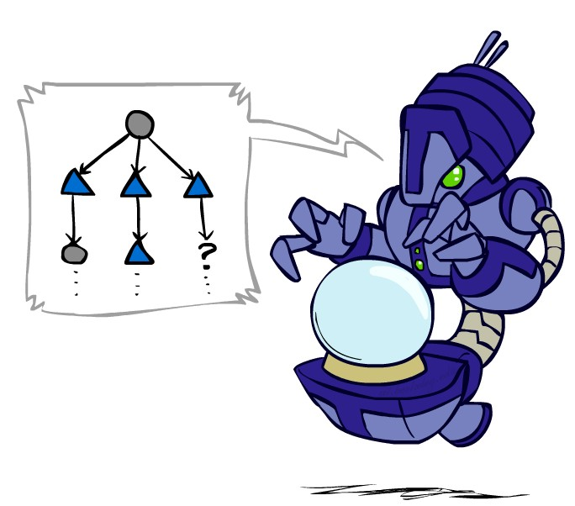
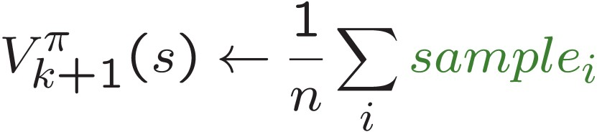
Sample-Based Policy Evaluation?
We want to improve our estimate of V by computing these averages:
Idea: Take samples of outcomes s’ (by doing the action!) and average
s
π(s) s, π(s)
s, π(s),s’
s₂' s's₁' s₃'
Almost! But we can’t rewind time to get sample after sample
from state s.

Slide 29
Temporal Difference Learning
Big idea: learn from every experience!
  Update V(s) each time we experience a transition (s, a, s’, r)
  Likely outcomes s’ will contribute updates more often
s
π(s)
s, π(s)
Temporal difference learning of values
  Policy still fixed, still doing evaluation!
  Move values toward value of whatever successor occurs: running average
Sample of V(s):
s’
Learning rate
Update to V(s):
Same update:

Slide 30
Example: Temporal Difference Learning
States
Observed Transitions
B, east, C, -2
C, east, D, -2
 | A
B | C | D
 | E
 | 0
0 | 0 | 8
 | 0
 | 0
-1 | 0 | 8
 | 0
 | 0
-1 | 3 | 8
 | 0
Assume: γ = 1, α = 1/2

Slide 31
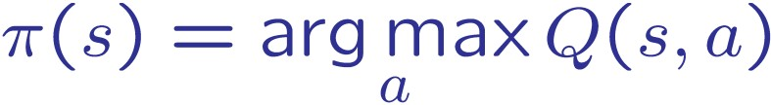
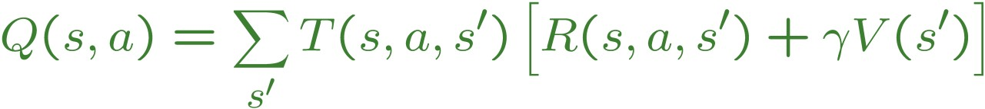
Problems with TD Value Learning
TD value leaning is a model-free way to do policy evaluation,
mimicking Bellman updates with running sample averages
If we want to turn values into a (new) policy, we can learn Q-values, not state values
V*(s)
s
s is a
state
a
(s, a) is a
q-state
Q*(s,a)
s, a
T(s,a,s’)
s’
(s,a,s’) is a
transition
Idea: learn Q-values, not values
Makes action selection model-free too!
V*(s’)

Slide 32
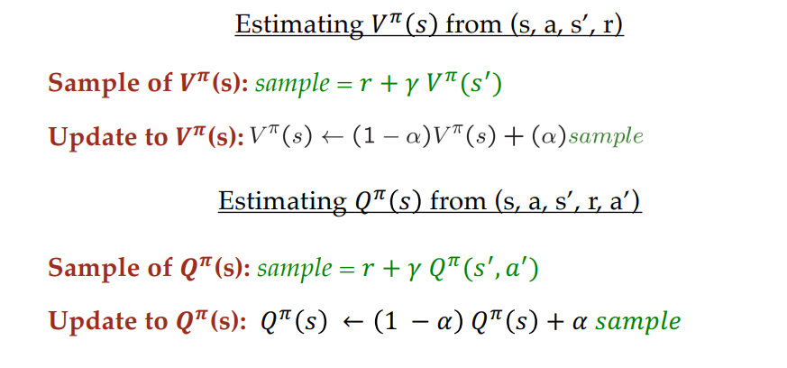
prediction of Q-values

Slide 33
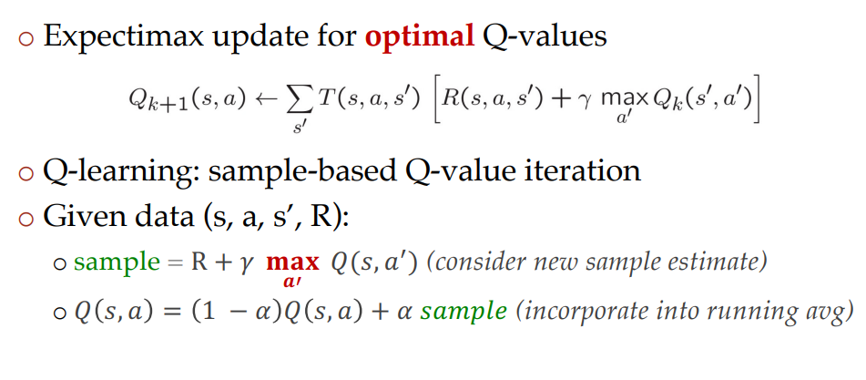
Q-learning

Slide 34
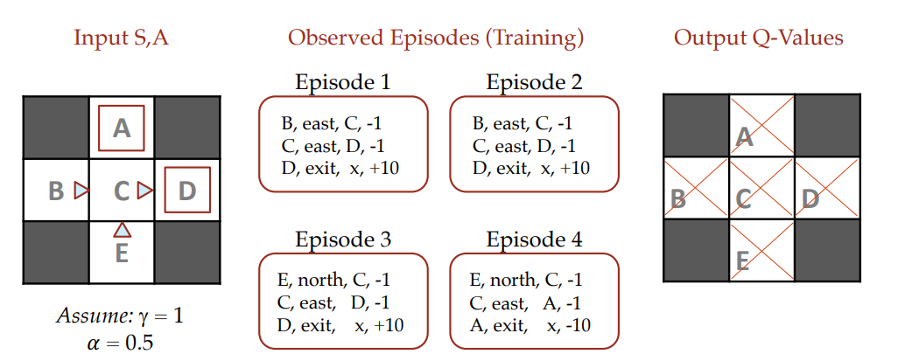
Q-learning

Slide 35
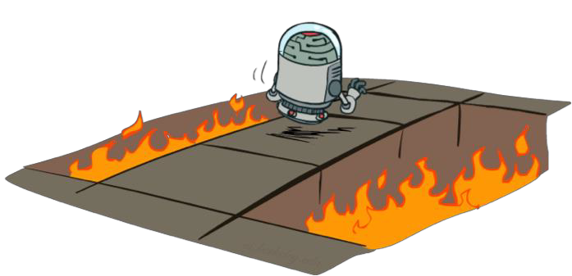
Active Reinforcement Learning
Full reinforcement learning: optimal policies (like value
iteration)
  You don’t know the transitions T(s,a,s’)
  You don’t know the rewards R(s,a,s’)
  You choose the actions now
  Goal: learn the optimal policy / values
In this case:
  Learner makes choices!
  Fundamental tradeoff: exploration vs. exploitation
  This is NOT offline planning! You actually take actions in the world and find out what happens…

Slide 36
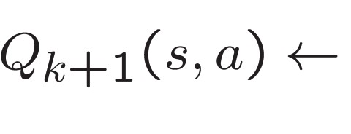
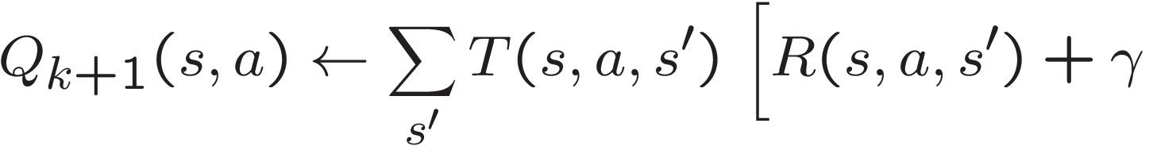
Detour: Q-Value Iteration
Value iteration: find successive (depth-limited) values
  Start with V₀(s) = 0, which we know is right
  Given V_{k}, calculate the depth k+1 values for all states:
But Q-values are more useful, so compute them instead
  Start with Q₀(s,a) = 0, which we know is right
  Given Q_{k}, calculate the depth k+1 q-values for all q-states:

Slide 37
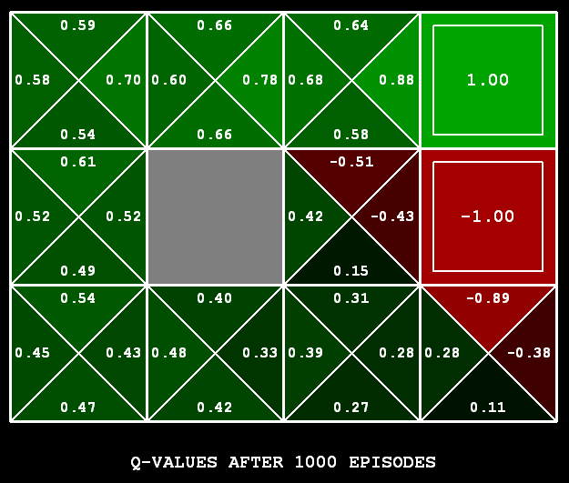

Q-Learning
Q-Learning: sample-based Q-value iteration
Learn Q(s,a) values as you go
  Receive a sample (s,a,s’,r)
  Consider your old estimat
  Consider your new sample estimate:
no longer policy evaluation!
  Incorporate the new estimate into a running averag
e:
e:
[Demo: Q-learning – gridworld (L10D2)] [Demo: Q-learning – crawler (L10D3)]

Slide 38
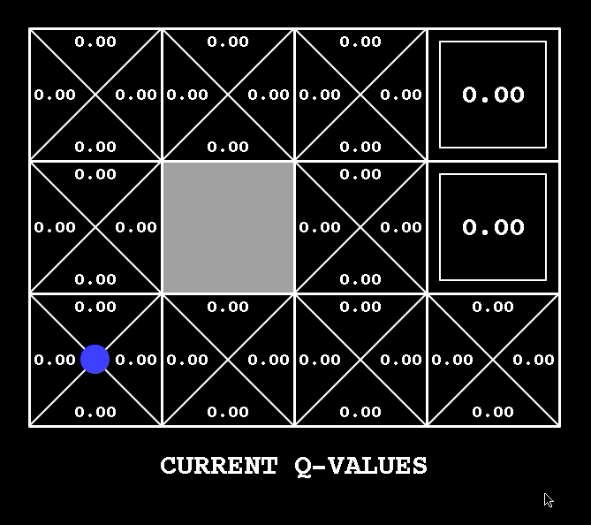
Q-Learning Demo

Slide 39
The Story So Far: MDPs and RL
Known MDP: Offline Solution
Goal
Compute V*, Q*, π*
Evaluate a fixed policy π
Technique
Value / policy iteration
Policy evaluation
Unknown MDP: Model-Based
Unknown MDP: Model-Free
Goal
Compute V*, Q*, π*
Evaluate a fixed policy π
Technique
Goal
Compute V*, Q*, π*
Evaluate a fixed policy π
Technique
VI/PI on approx. MDP
Q-learning
PE on approx. MDP
Value Learning

Slide 40
What Just Happened?
That wasn’t planning, it was learning!
  Specifically, reinforcement learning
  There was an MDP, but you couldn’t solve it with just computation
  You needed to actually act to figure it out
Important ideas in reinforcement learning that came up
  Exploration: you have to try unknown actions to get information
  Exploitation: eventually, you have to use what you know
  Regret: even if you learn intelligently, you make mistakes
  Sampling: because of chance, you have to try things repeatedly
  Difficulty: learning can be much harder than solving a known MDP

